Slide 1
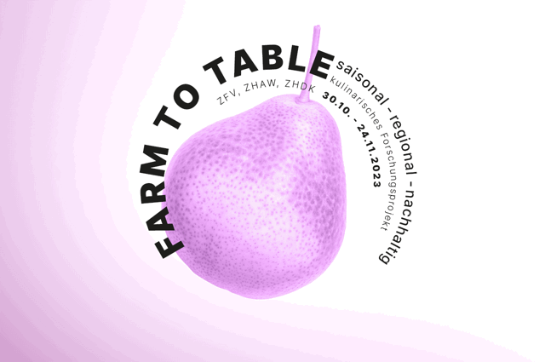



Regenerative
Foodprocessing
All Streams are
Mainstream
for Planetary Health
Tnote 19.11.2023 @ Toni Areal Zürich

Slide 2
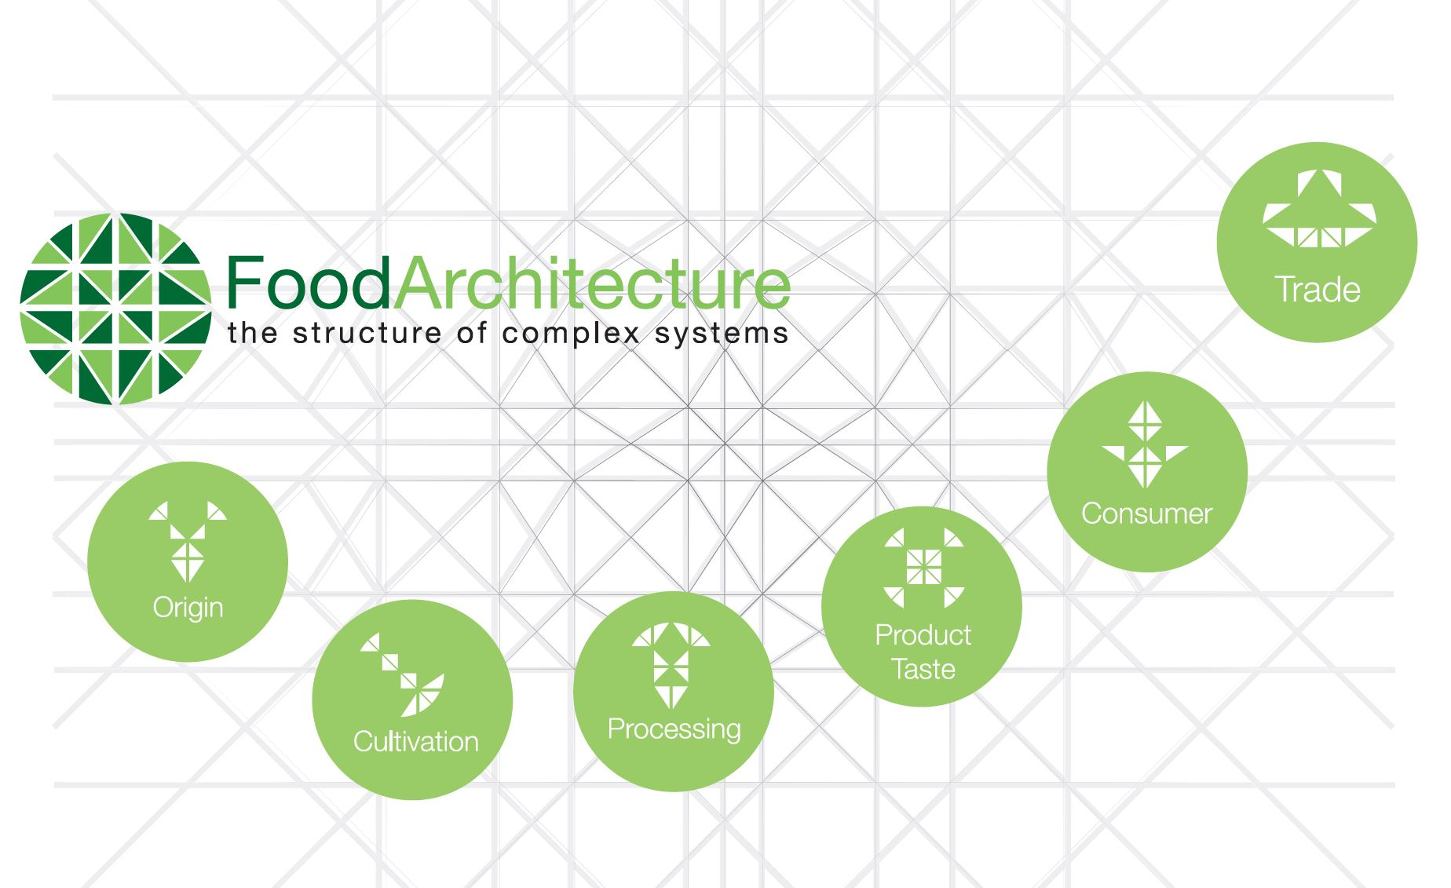
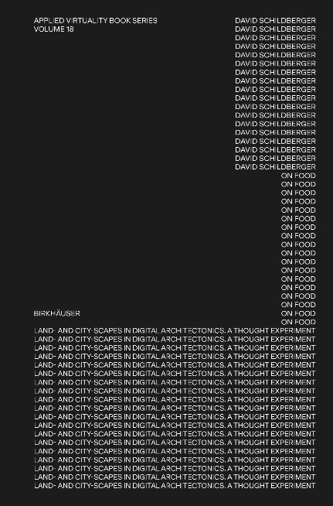
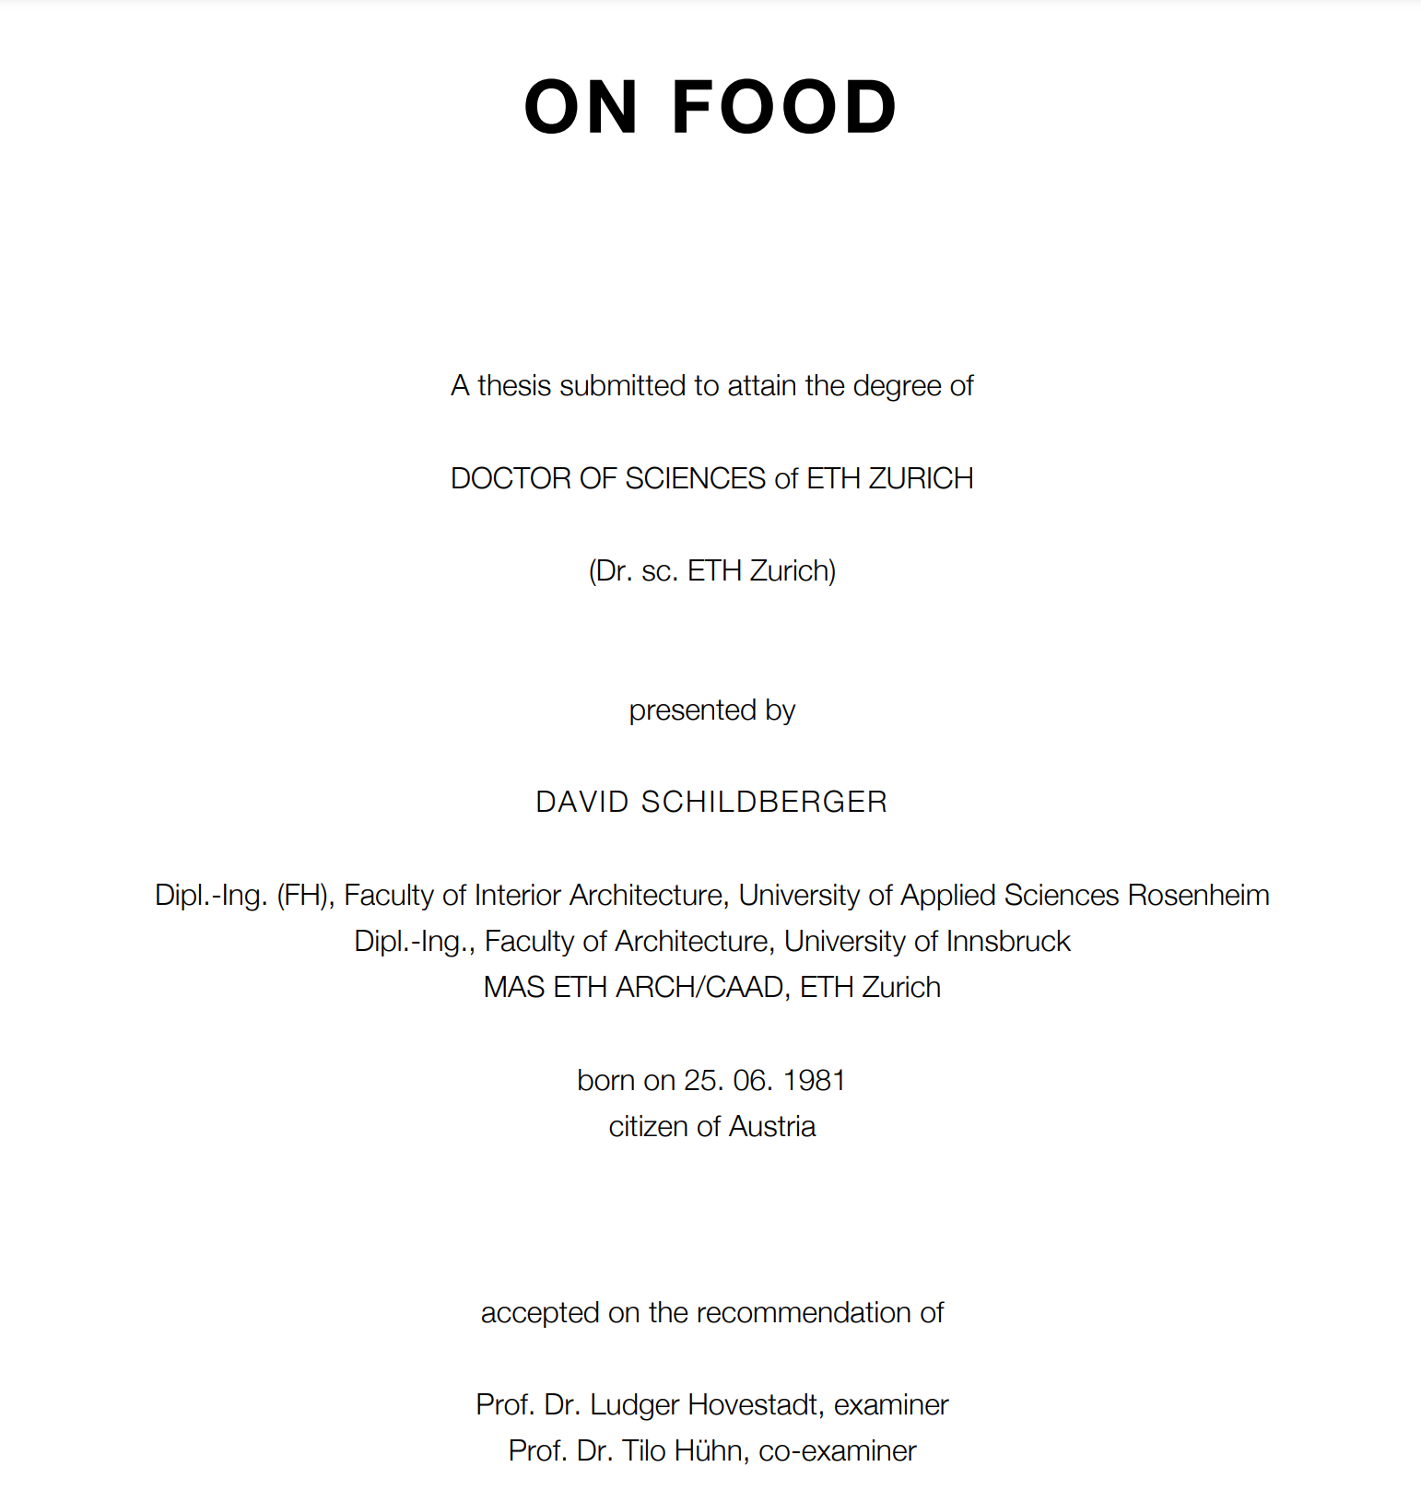

Innovation for Planetary Health

Slide 3


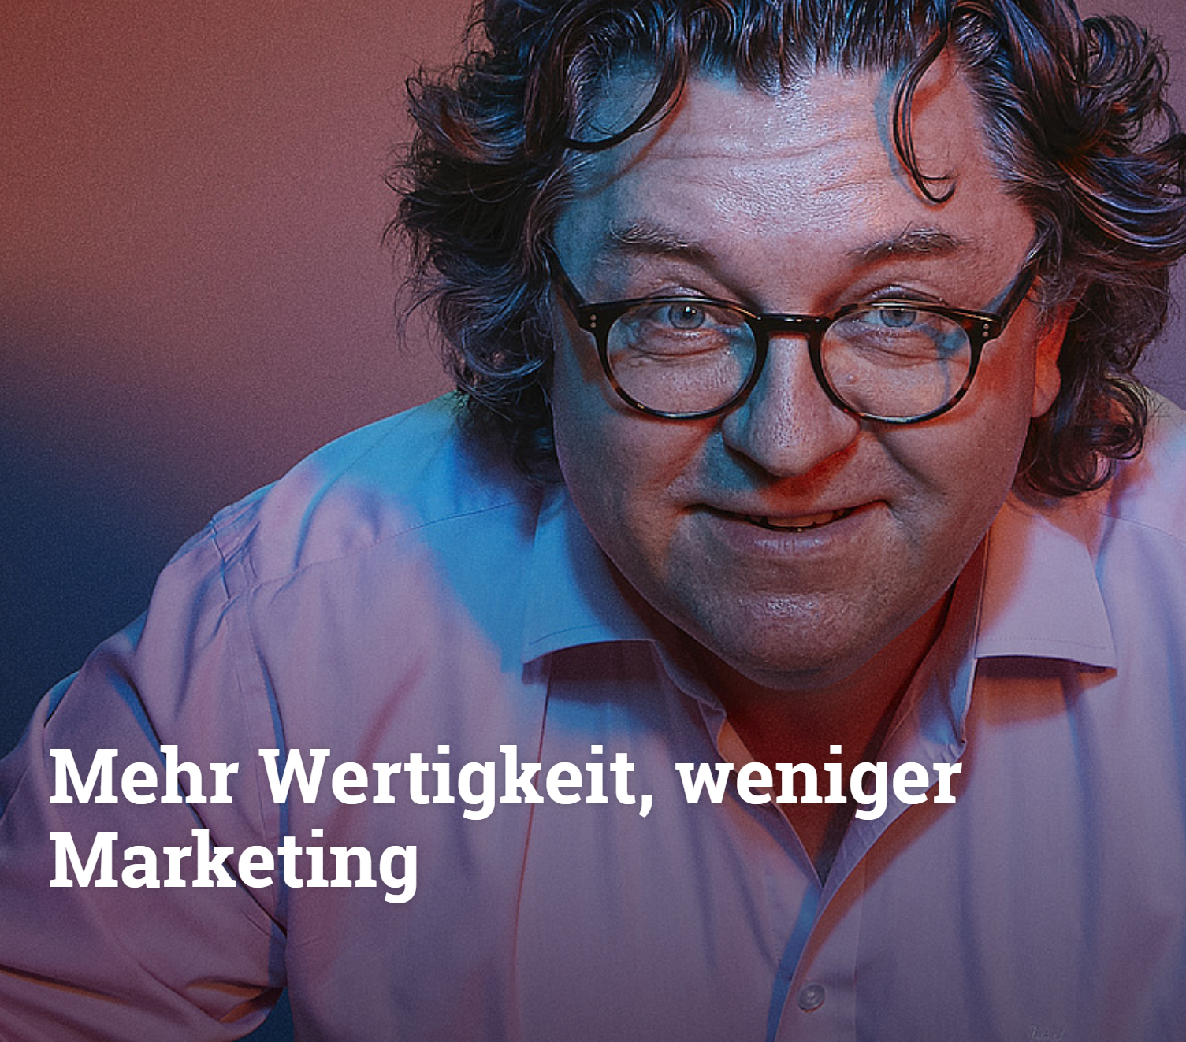
Architecture is fundamental to any comprehensive understanding of culture.
The approach of including food as nutrient and requisites for self-staging ties in with reflections on the relationship between being and dwelling.
Heidegger (Building, Dwelling, Thinking: 1953) posits dwelling as the fundamental form of human existence by relating it to building.
Relationships between growing, preparing, preserving, eating, drinking, and living are preconditions of existence.
The transmission of the knowledge of the means of life, as well as the acquisition of the skills to produce and use them, forms the basis of human development.
The agronomic and industrial production of raw materials and food, trade, preparation and presentation, express man's ability to organize her/his/it’s environment in terms of meaningful consumption of food and drink, and thus to articulate his cultural world.
Through FoodArchitecture, individual cultures, as well as humanity as a whole, express themselves and develop approaches of a common understanding of the world.
Only by confronting the food habits of another culture and the resulting consequences can we recognize their otherness and develop approaches for common action in a growing alliance of the willing to regenerate life on the planet.
Hühn, T. (2018) FoodArchitecture, ZHAW, Wädenswil.

Slide 4
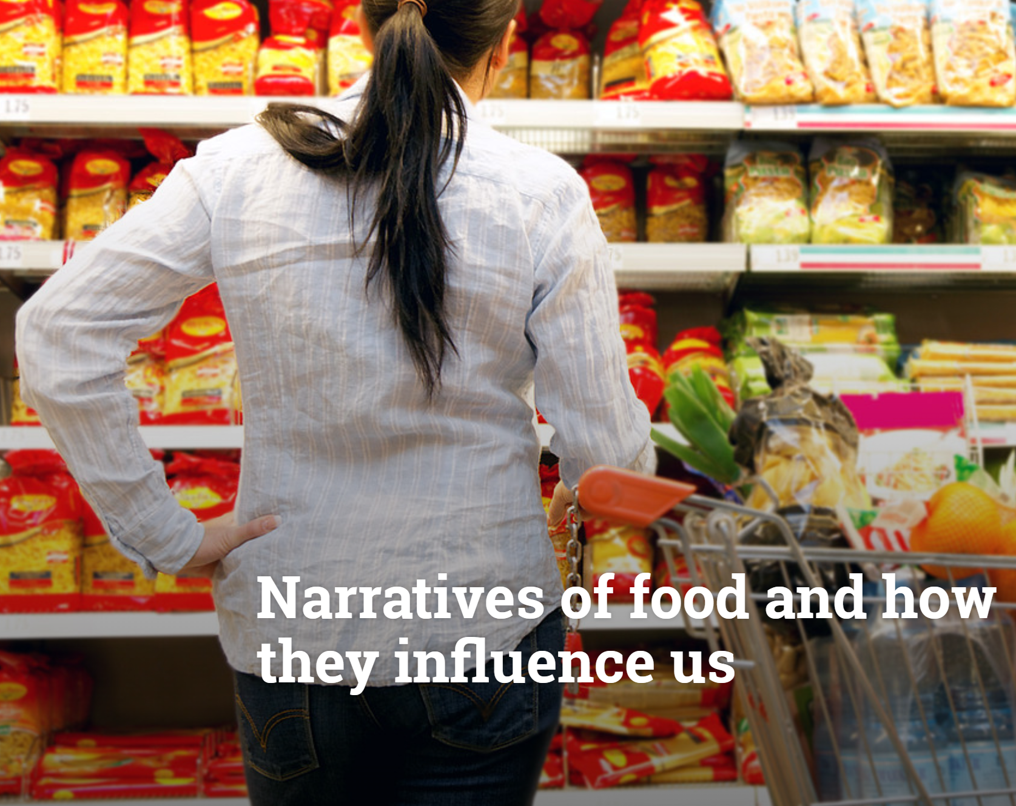
Narratives of food
Narratives such as "The battle to save the planet is won on the plate" raise awareness that impact is created with every decision we make about what we eat.
After a period in which parts of society in the Western world followed a value orientation in which many things came with a price tag, a greater emphasis on works is occurring via an increasing debate on values in mature economies.
This work orientation is characterized by the reflection process that with the production of food and services effects arise and these are to be subjected to a more comprehensive consideration.
Props of self-portrayal
You are what you eat!
Hühn, G.& T. (2021) Narratives of food, ZHAW, IMPACT.

Slide 5
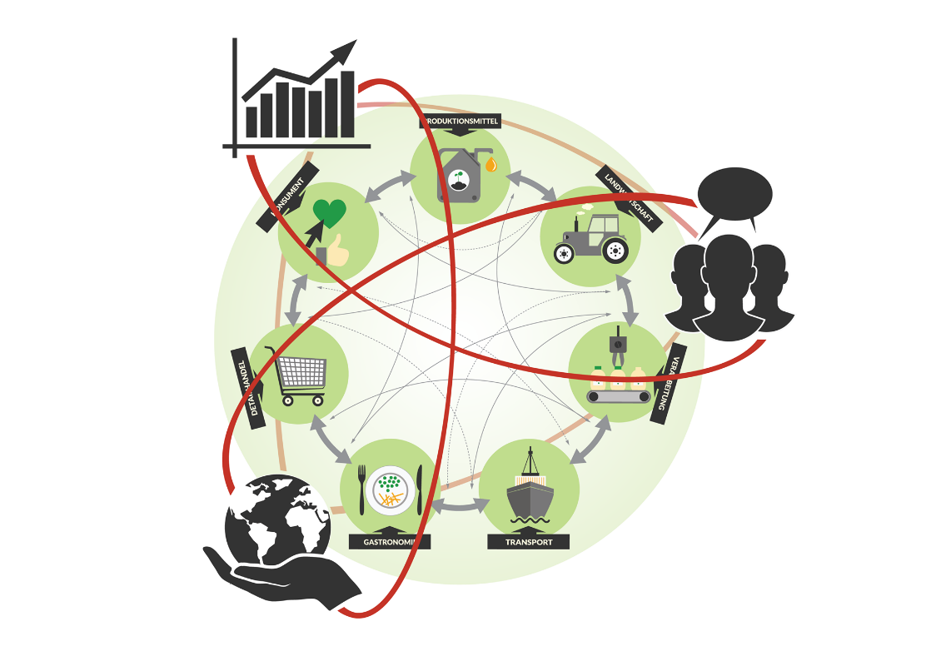
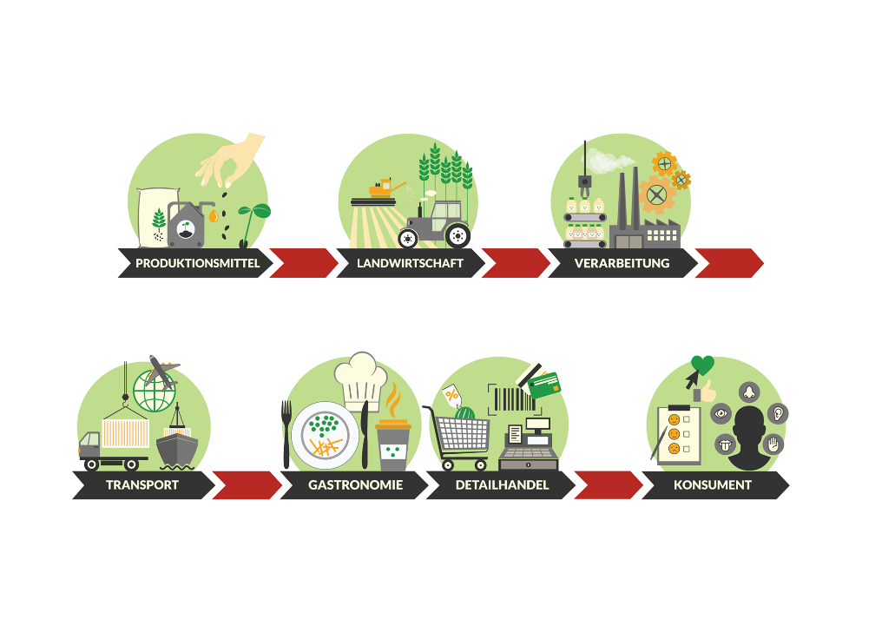
Transparency:
Trusted Food
Assymmetric Information:
Exploitation
From delegated
to shared responseAbility
VALUES RESPECTED
From Value-Chain
to -Network
FOOD UNCHAINED

Slide 6
SustainAbility &
Re-Generation
Thriving for Resilience
Re-Generation
Repair & Prepare
SustainAbility
Protect & Survive

Slide 7

Settlement
Subsistence
Industrialization
Exploitation
Human
Consumption
Population
growing
Planetary
Health
Biodiversity
shrinking
Sustainability
Protection
From Doughnut*- to
Regenerative-Economy
Sufficiency: Insufficient
Protection is not enougth
Regeneration
Curation
Kate Raworth
Dougnut Economy, 2017
Hühn, T. (2021) Planetary Health, ZHAW, Wädenswil.

Slide 8
From Exploitation
to Curation
Industrialization : Regeneration
Macrobiom
Interaction, relation, structural coupling: biocenosis
Holobiom
Autopoiesis : Sympoiesis
Integration, determination, entanglement: evolution
James Ephraim Lovelock
Atmospheric Environment, 1972
Humberto Maturana & Francesco Varela
The tree of knowledge, 1987
Donna Harraway
Stay with the trouble, 2018
Microbiom
Adaption, nutrition, metabolism:
salutogenesis
Homöostasis : Homöodynamic
Hühn, T. (2022) From Exploitation to Curation, ZHAW, Wädenswil.

Slide 9

The most relevant Questions on Food
besides Price
4
Origin
Where does it come from?
Processing
How is it made?
Health
What is in my Food?
Ethics
Does it harm me, my family, other people, animals, the environment?
Hühn, T. (2021) The 4 most relevant Questions on Food, ZHAW, Wädenswil.

Slide 10
RX-Design
Regenerative User Experience
System Curation
Does the business model contribute to bio-, social-diversity, mitigate global warming and Planetary Health?
Resource Utilization
Is there a conscientious use of resources and sourcing of materials, are the emissions to the environment minimized, the usage of renewable energy granted, and the social values respected?
Economic Resilience
Is there a fair treatment of all members of the network and does the operation contribute to create and sustain a long-term regenerative economy?
Stream Valorization
Are all streams respected as mainstream
and are they valorized to reduce
Food-Waste?
Up-/re-cycling Potential
Are the molecules, materials, and substrates composed in a way that optimizes impact generation and
up-/re-cycling capabilities?
From UX and SX
to RX-Design
INTERCONNECTED EXPERIENCE
Product
Process
Hühn, T. (2022) Regenerative User Experience, ZHAW, Wädenswil.

Slide 11


Slide 12
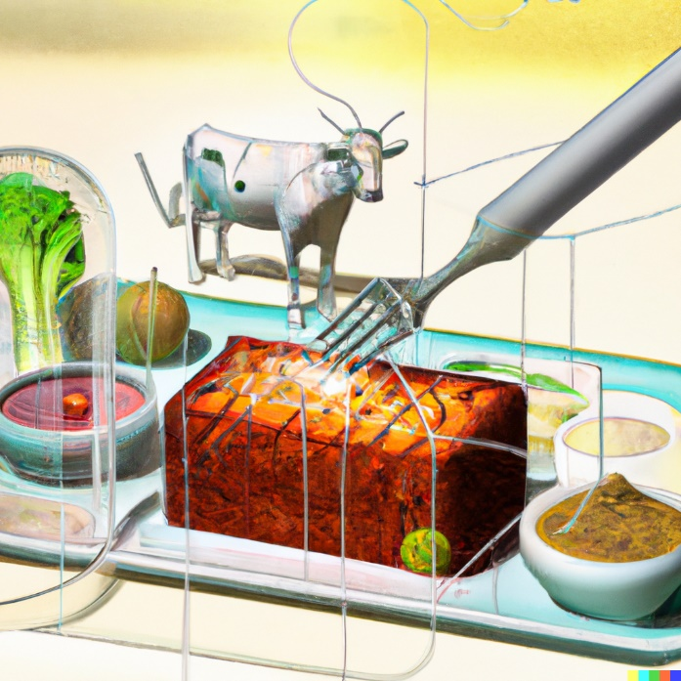

Types of Protein Sources
(Selection)
Cultivated
Fermented
Synthesized
farmed
celled
spontaneous
pure strains
edited strains
CO₂
CH₄
Algae
Plants
Xanthobacter
Methanobacter
Fungus
Insects
Plants
Chicken
Insects
Fish
Lifestock
Pigs Beef
01.2023

Slide 13

Classification vs Standardization
Enables inclusive processing of fluctuating raw materials through detection, classification and process modification rather than standardizing and discarding raw materials because criteria are not met.
LABTORY
Unites Laboratory and Factory, experimentation and production,
observes and optimizes continuous processes
through automated thinking, modulation, simulation and control to enable regenerative foodmanufacturing.
Hühn, T. (2021) LABTORY – Regenerative Processing by Automation, ZHAW, Wädenswil.

Slide 14

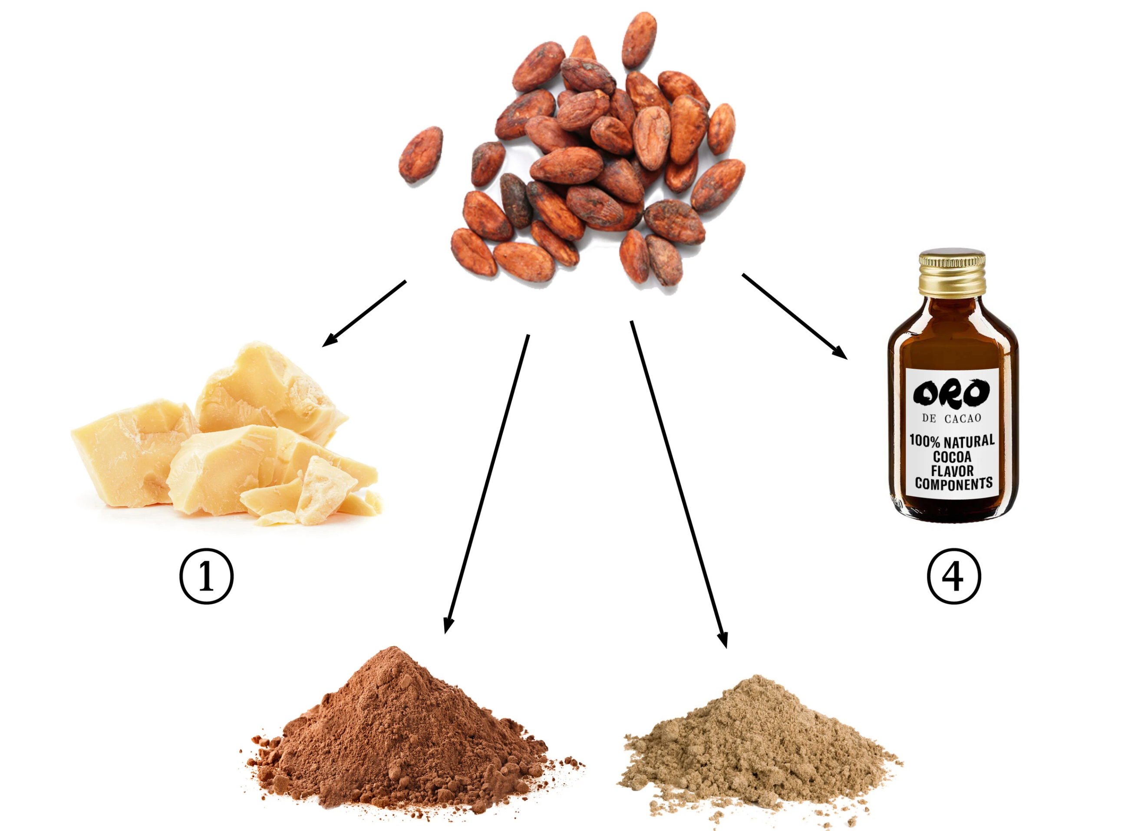
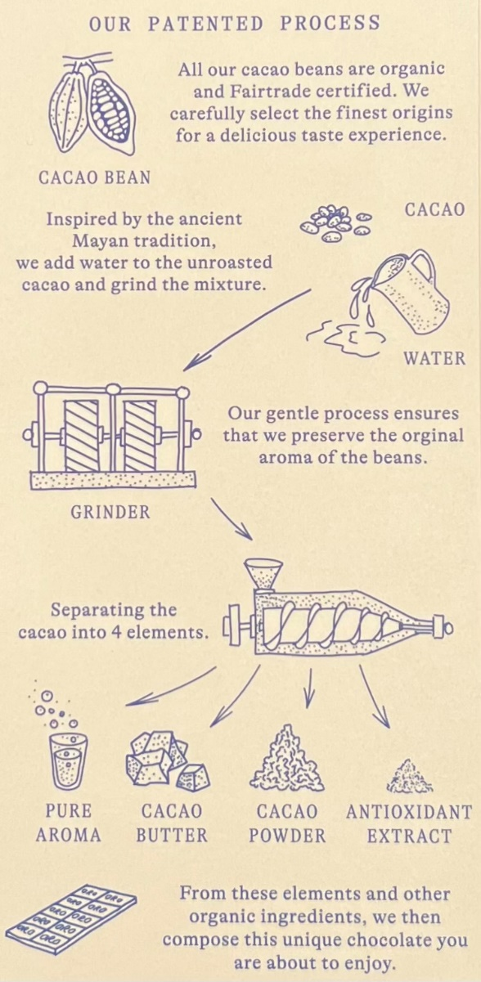

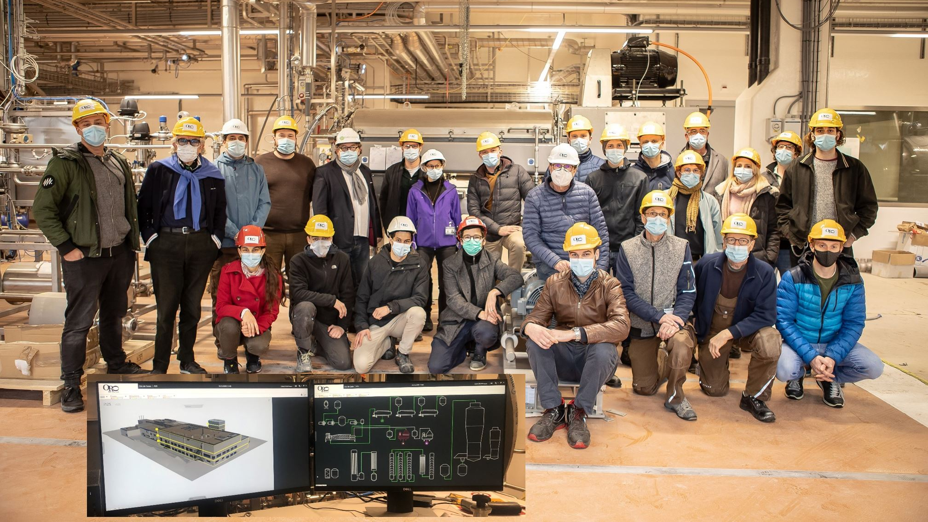


XOCOATL
Extraction
at Temperatures < 50°C
leads to more Aroma which represents Variety, Region, Vintage
with Water
reduces the concentration of acetic acid, therefore volatile acidity
and bitter impact
delivers 4 Elements
Cocoa Butter, Aroma, Cocoa Powder and Cocoa Dry Extract,
combined to different food and functional products
enables additional Value creation
by mainstreaming all products especially polyphenols

Slide 15


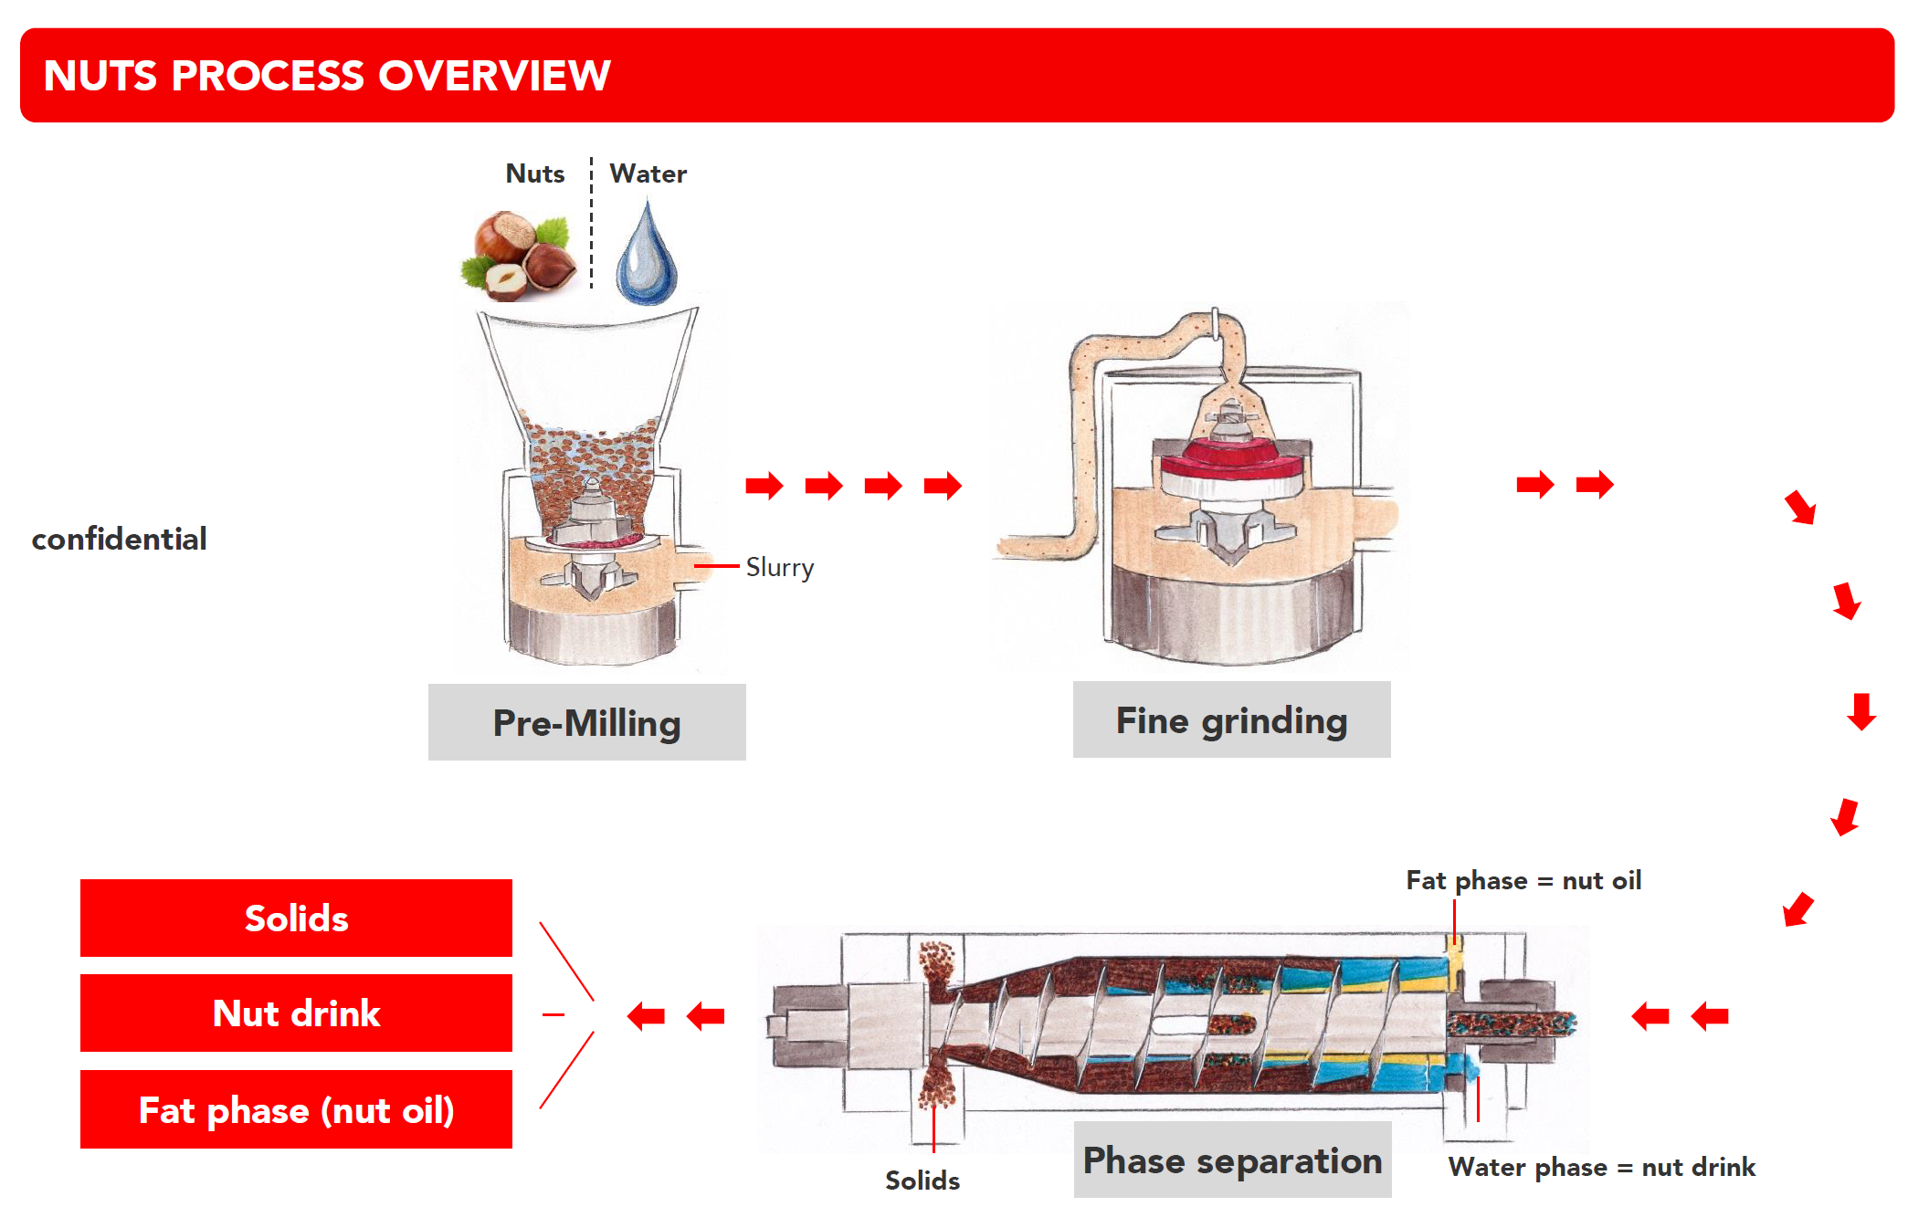
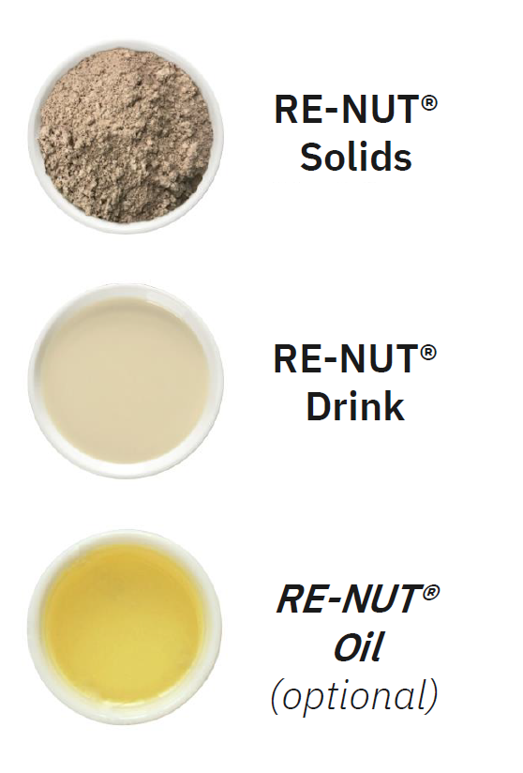
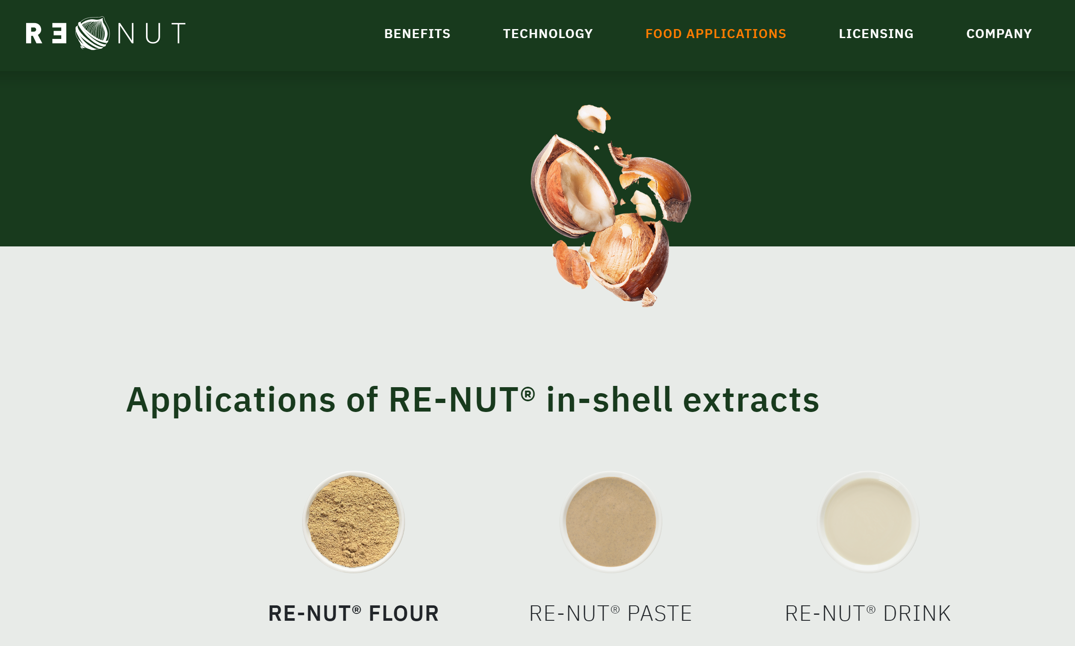
In-shell nut processing

Slide 16

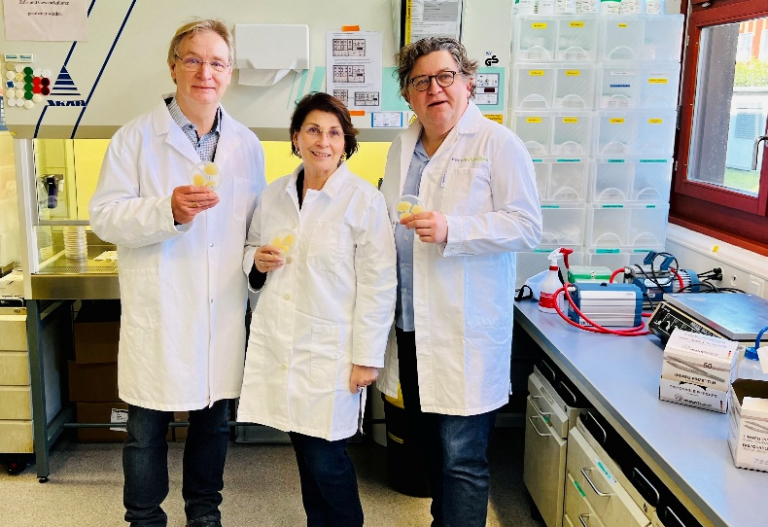
Biotransformation vs Dissipation
Enables molecular Upcycling on the base of whole plants through the production of concentrated cell feed to reduce food waste and contribute to curate the system for planetary health.
CULTURY
Unites regional and regenerative production of agricultural products as a substrate with plant-based cell cultures for the generation of active Ingredients and a base for personalized food.

Slide 17
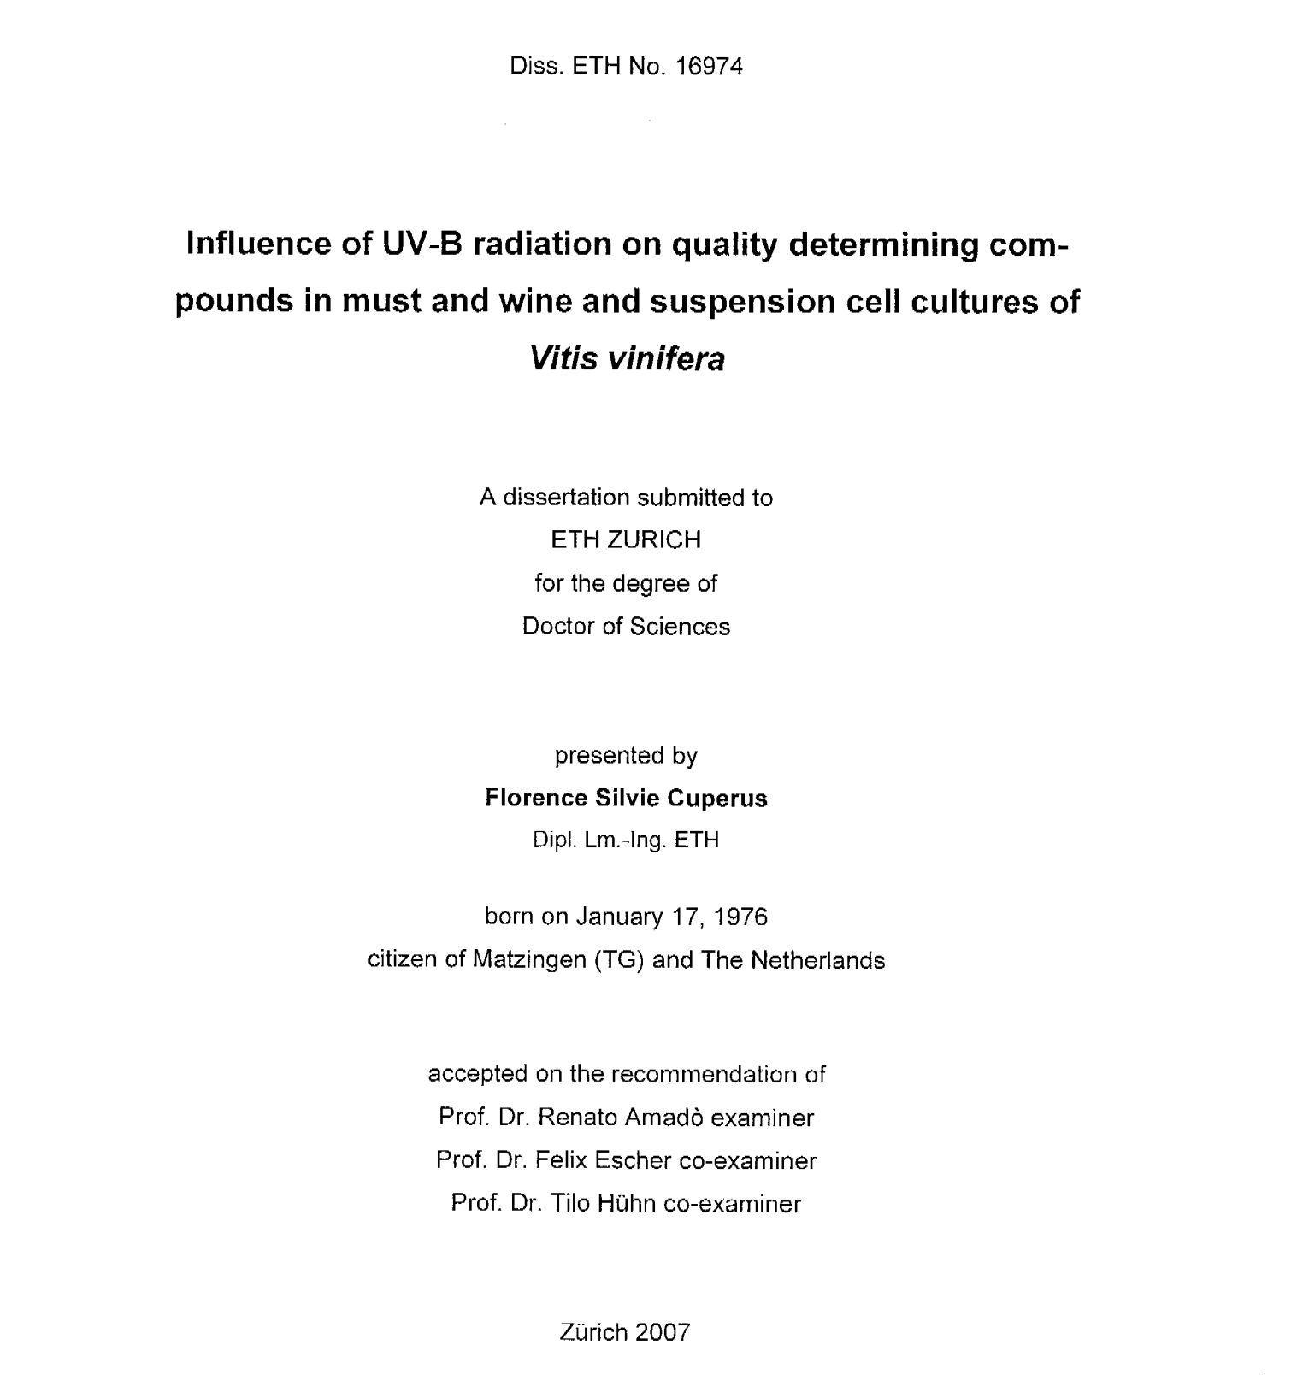
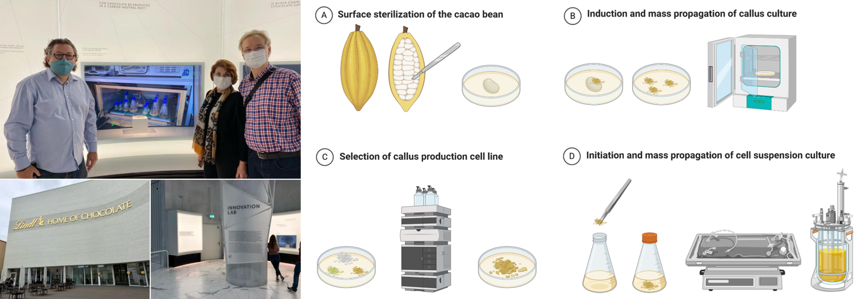
Cellular Agriculture: Chocolate from the tank
Regine & Dieter Eibl
Pioneers of Cell Culture Research

Slide 18
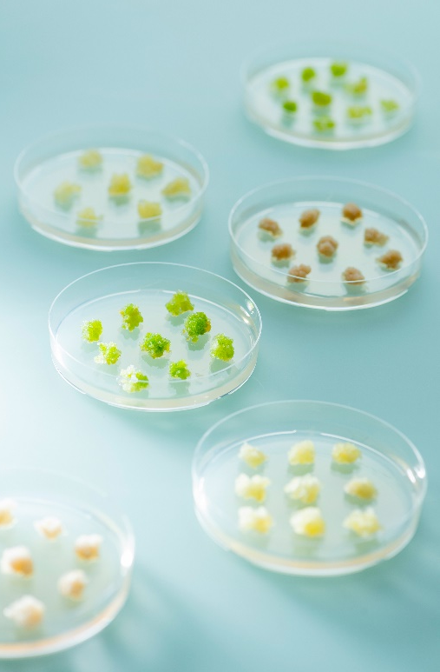
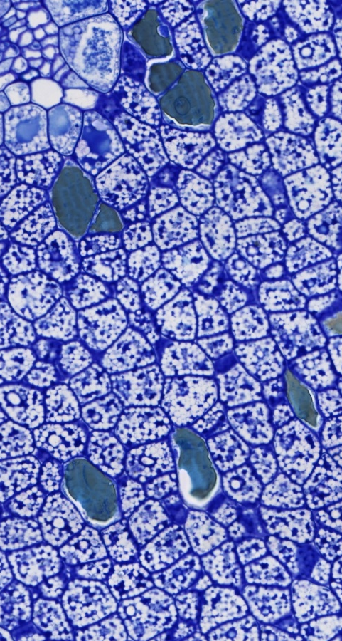


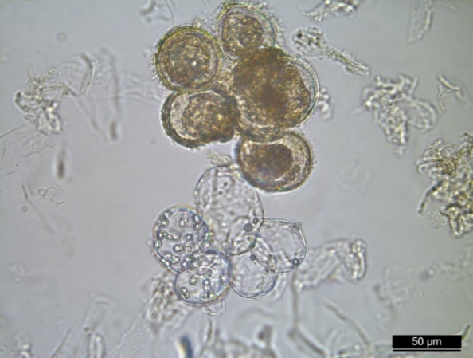
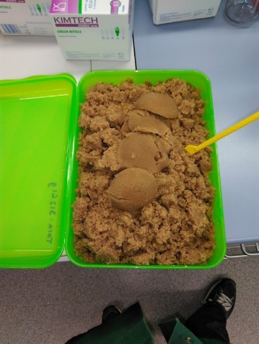
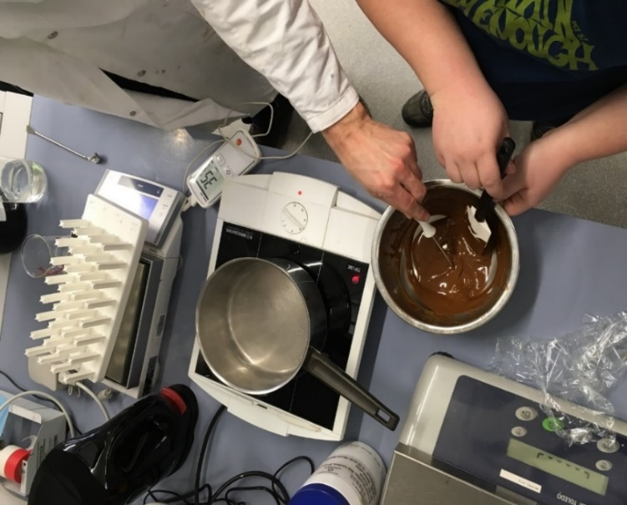
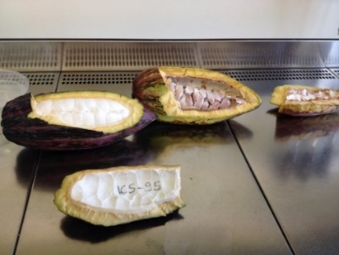
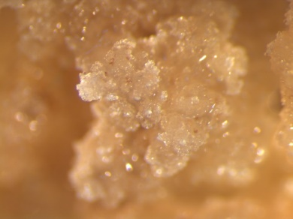
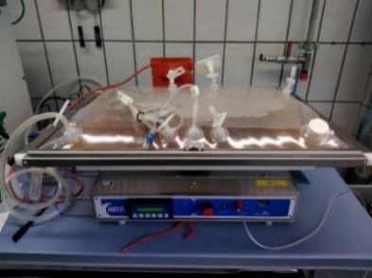

  Production of chocolate bars with suspension cells of the cacao tree
  Establishment of the cell culture from one freshly harvested, immature pod (USDA-ARS Tropiculture Research Station, Puerto Rico)
  Callus induction by wounding the seeds
  Callus propagation in petri dishes
  Transfer into shake flasks to initiate formation of suspension cells
  Propagation of suspension cells in shake flasks and a wave-mixed bioreactor
ZHAW, Wädenswil / Photo: Ansgar Schlueter 2016
ZHAW, Wädenswil / Photo: Frank Brüderli

Slide 19
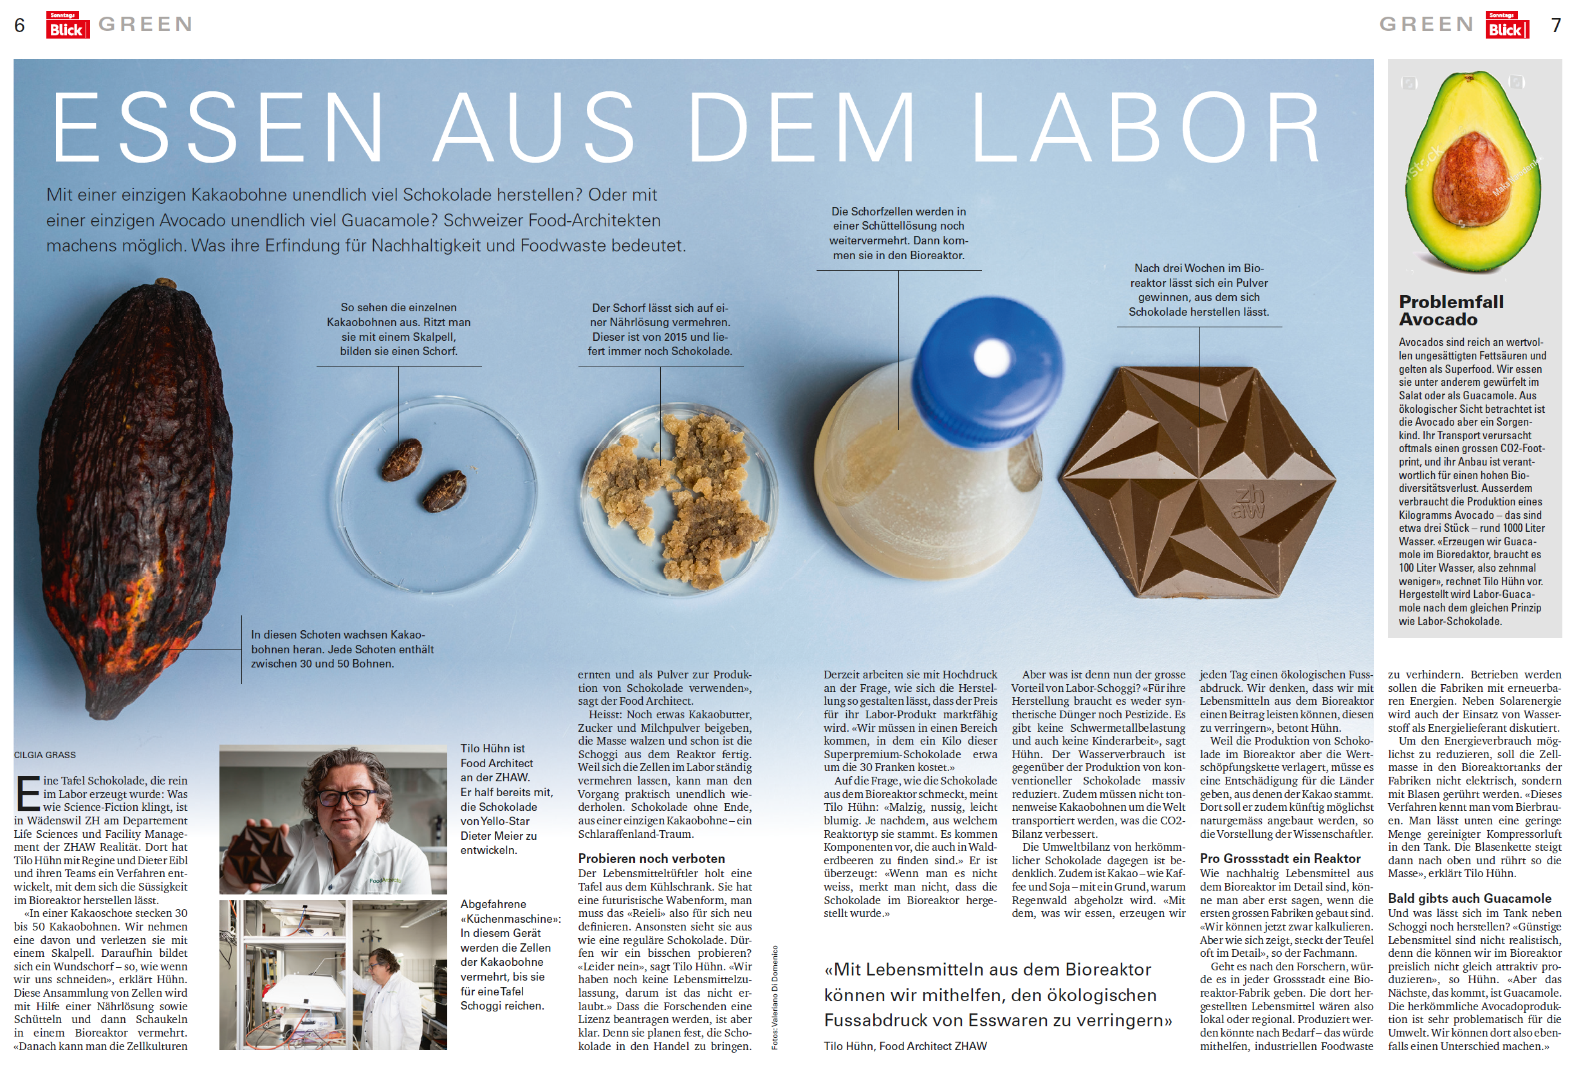

Slide 20
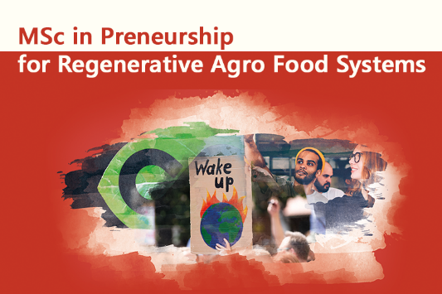
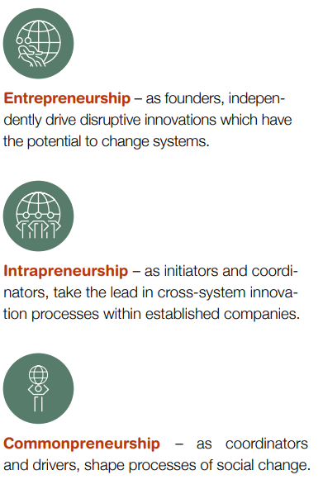
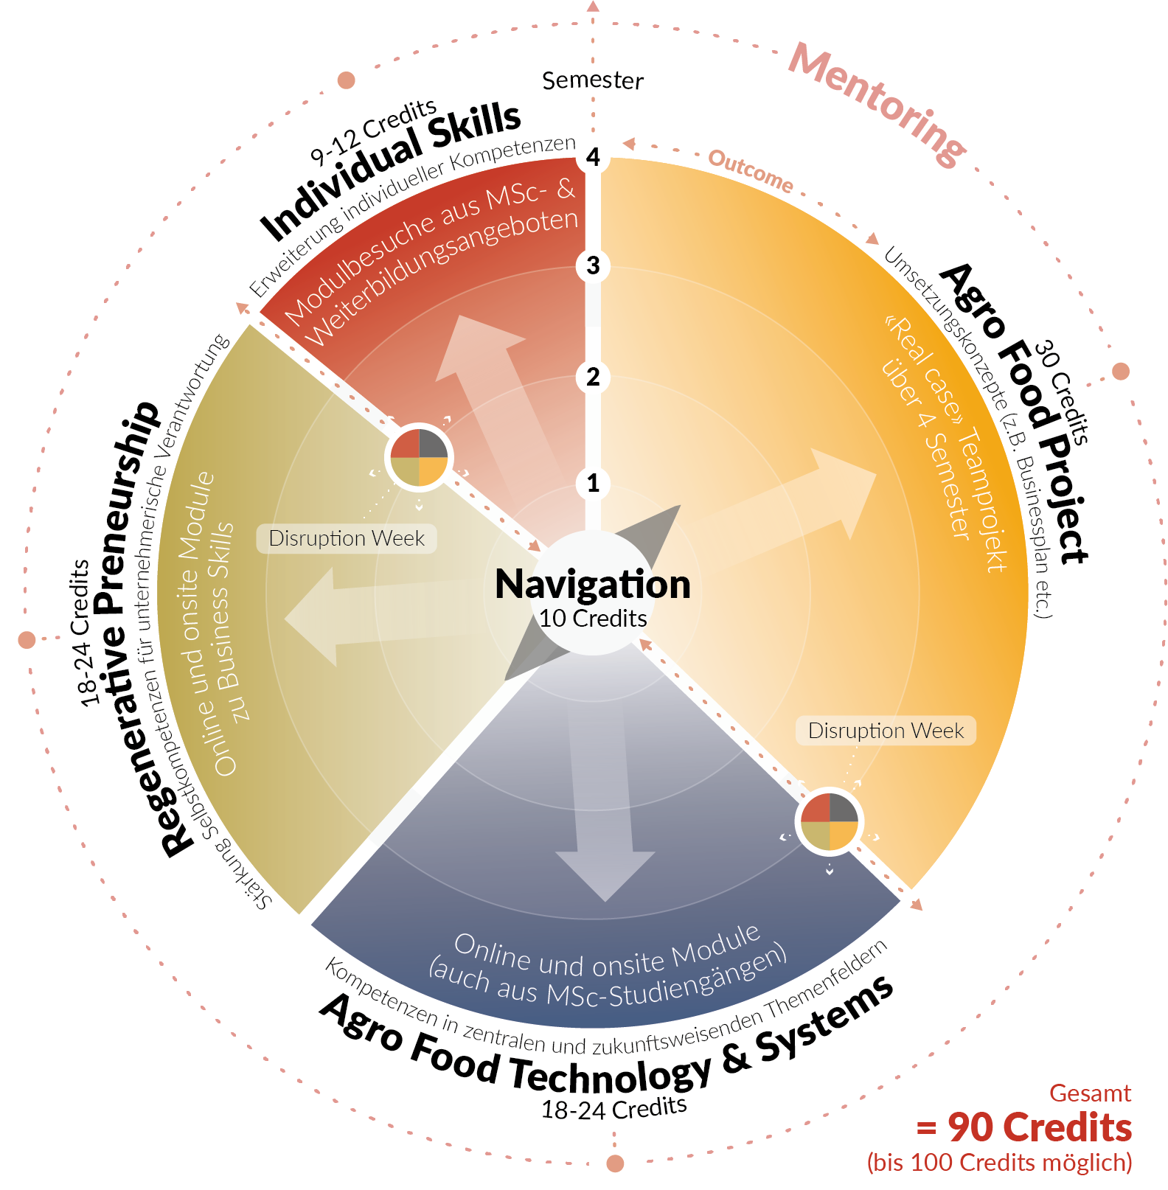


Slide 21
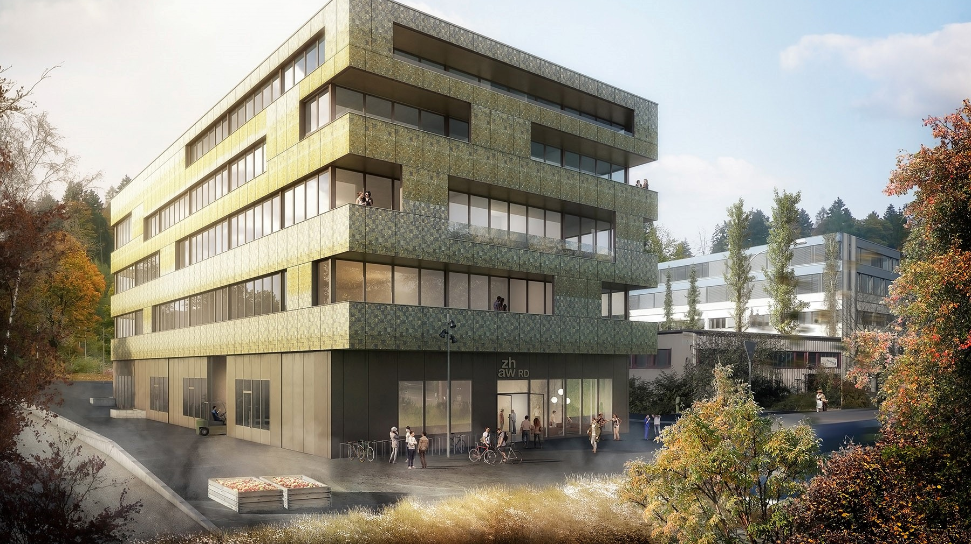

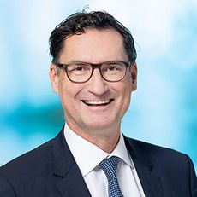
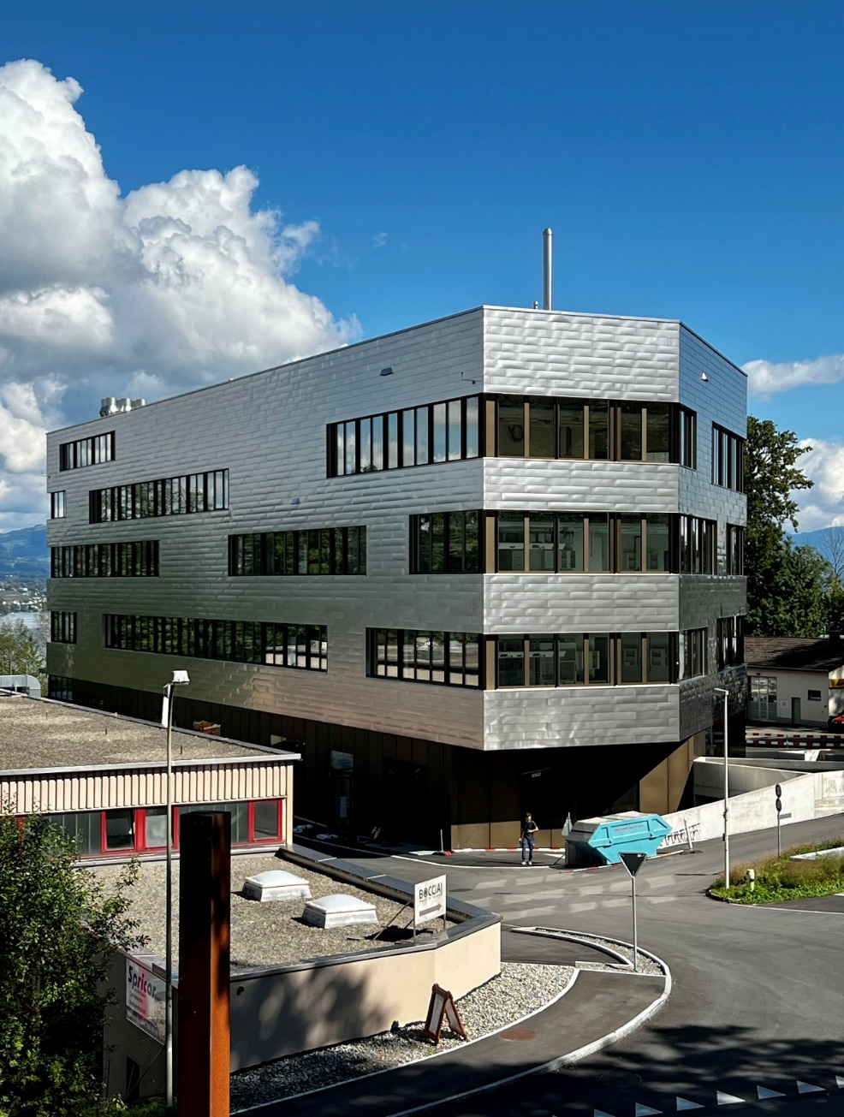
Future of Food Campus Wädenswil
«Genussvolle, gesunde, sichere und nachhaltige Lebensmittel.
Dies ist der Leitsatz, nach dem wir aus- und weiterbilden,
forschen und entwickeln.»
Prof. Michael Kleinert
Institutsleiter
Prototyping from proof of experiment to
proof of product, process, concept
in the fields of:
Sustainable Packaging
Regenerative Foodprocessing
Fermentation and Biotransformation

Slide 22
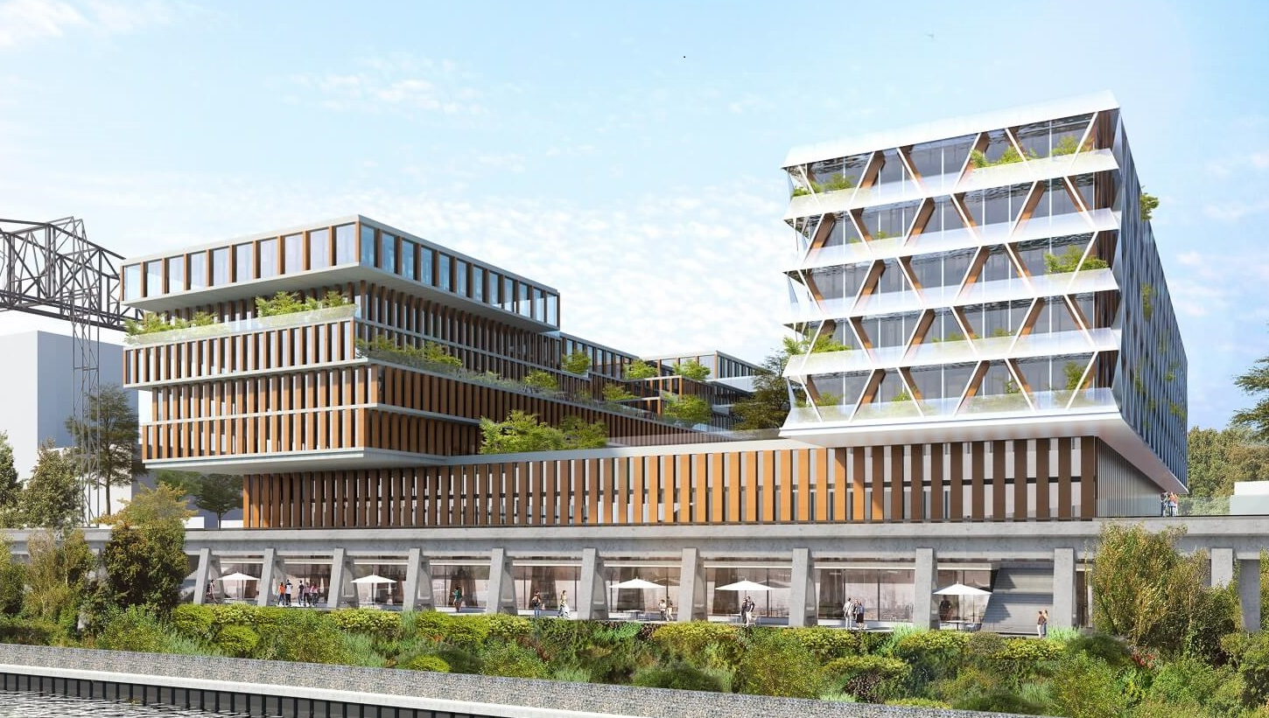

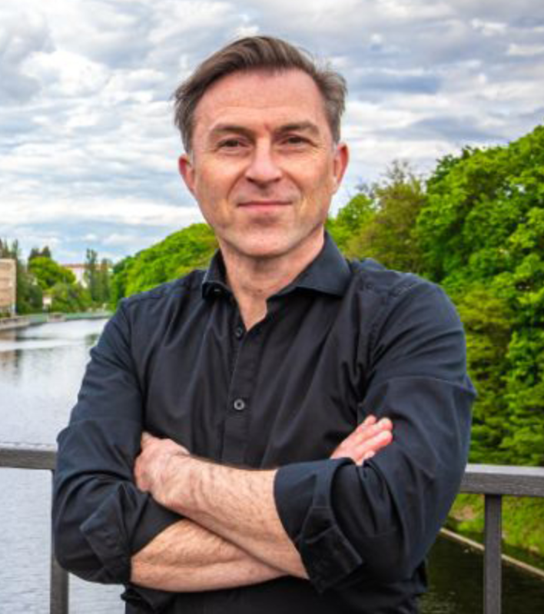
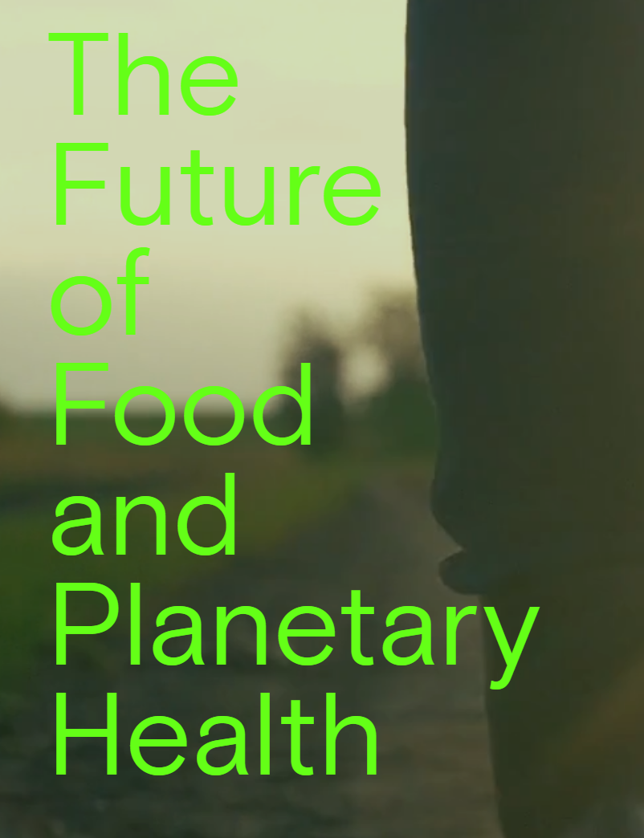
«Die Schlacht um die Nachhaltigkeit wird
auf dem Teller entschieden.»
Jörg Reuter
Projektleiter
Ecosystem of Ecosystems
building a Community for Change
Network

Slide 23
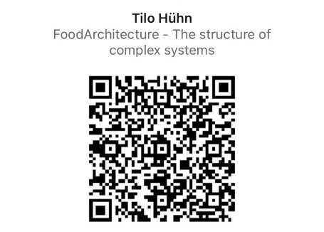

  Beyond sustainability - it’s about regeneration, within planetary limits and social thresholds.
  From value chain to a transparent value network with shared responsibility.
  Holistic User Experience (Consumption, Sensory, Regeneration) by interconnection.
  Mainstream all streams, upcycle molecules and regenerate the system.
Mobil. +41 79 472 9749
tilohuehnprocessdesign

